Slide 1

18ECC301T – Wireless Communications
Unit IV –Improvement on Link Performance
Week 1 : Introduction to diversity, equalization and capacity, Space diversity, Scanning diversity, Maximal ratio combiner, Equal gain diversity,
Week 2: Rake Receiver, Capacity in AWGN, Capacity of flat fading channels, Equalizer and its mode, Adaptive equalizer block diagram
Week 3: Types of Equalizers - elementary level only, Introduction to MIMO antennas, Case study: Recent trends in Diversity and MIMO antenna
References :
Rappaport T.S, “Wireless Communications: Principles and Practice”, Pearson education, 2nd edition, 2009.
Andrea Goldsmith, “Wireless Communications”, Cambridge University Press, Aug 2005

Slide 2
WEEK-2
Types of Equalizers - elementary level only, Introduction to MIMO antennas, Case study: Recent trends in Diversity and MIMO antenna
Courtesy:
Rappaport T.S, “Wireless Communications: Principles and Practice”, Pearson education.

Slide 3
Types of Equalizers
types
structures
adaptive
algorithm
equalizer
linear
non-linear
DFE
ML symbol
detector
MLSE
Transversal
Channel
Estimator
transversal
lattice
transveral
lattice
0-forcing,
LMS, RLS
Fast RLS,
Sq. Root RLS
LMS, RLS,
Fast RLS
Sq. Roor RLS
LMS, RLS,
Fast RLS
Sq. Roor RLS
Gradient RLS
Gradient RLS

Slide 4
MIMO Wireless Communications
Single Input Single Output (SISO)
Tx
Rx
Ant 1 Ant 1
Fig. 1 SISO system
What will happen if Tx and Rx employs multiple antennas?

Slide 5
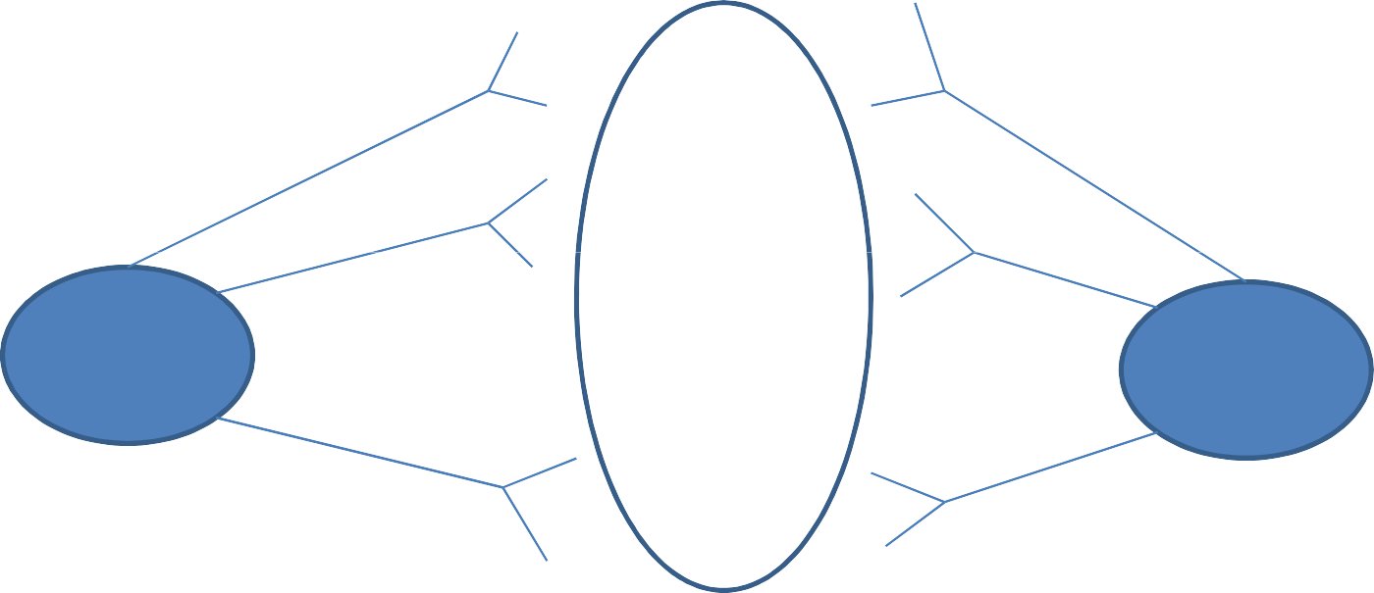
MIMO Wireless Communications
Multiple Input Multiple Output (MIMO)?
Ant 1
Ant 1
Ant 2
.
.
.
.
.
.
Ant 2
channel
Tx
Rx
Ant N_{T}
Ant N_{R}
Fig. 2 N_{T} × N_{R} MIMO system

Slide 6
MIMO Wireless Communications
What are advantages of MIMO?
Capacity (C) for Single Input Single Output (SISO) system
C = BW log₂ (1+ SNR)
Data rate increase when
Bandwidth (BW) and
Signal to noise (SNR) power increase
Inherent problems:
BW is precious, almost and always fixed for different applications

Slide 7
MIMO Wireless Communications
Signal power increase
battery lifetime decrease
creates higher interference needs expensive RF amplifier
In MIMO, spectral efficiency increase
Without increasing BW and
Signal power

Slide 8
MIMO Wireless Communications
But, how?
Basically two gains for MIMO systems:
– (i) MUX/rate gain
– Capacity behavior
R ≈ r log₂ (SNR)
lim
R(SNR)
r =
^{SNR → ∞} log ₂ (SNR)

Slide 9
MIMO Wireless Communications
For instance
How much is the achievable rate gain?
Ant 1
Ant 1
Ant 2
Ant 2
r=3
Tx
Rx
S/P
Ant 3
P/S
Ant 3
R ≈ 3log₂ (SNR)
Fig. 3 Achievable rate gain with 3 × 3 MIMO system

Slide 10
MIMO Wireless Communications
(ii) Diversity gain
Error probability behavior (minimize it) ^{P}_{e} ^{(SNR) ≈ SNR}
−d
Slope of symbol error rate/ bit error rate (SER/BER curve increases)
Behavior of error probability w.r.t. average transmit power in log-log scale
for asymptotically high power
log_{2 {}P_{e (}SNR_{)}}
lim
SNR → ∞
d = −
log₂ ₍SNR₎

Slide 11
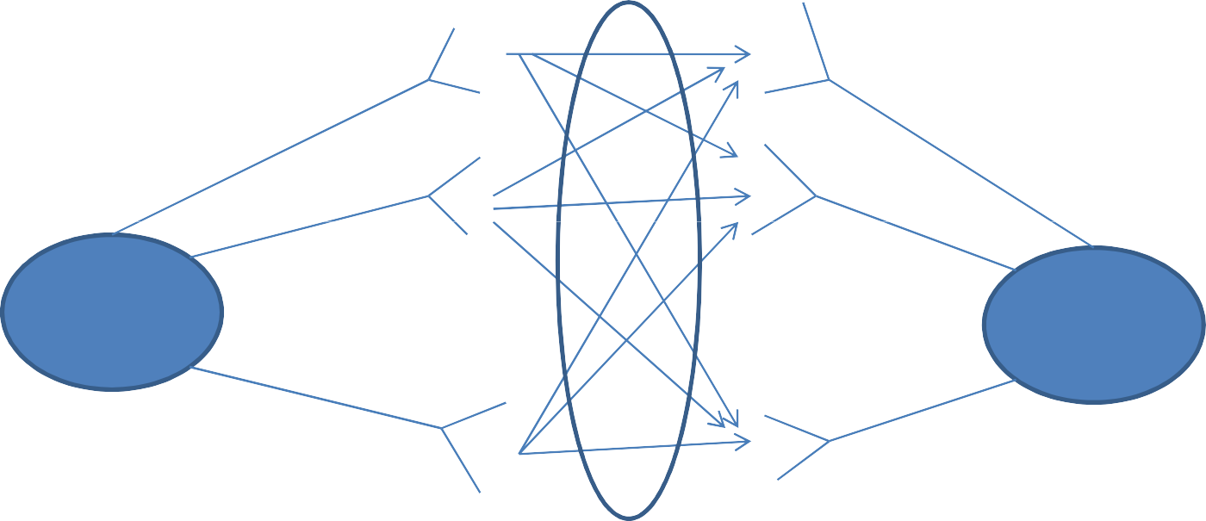
MIMO Wireless Communications
How much is diversity gain?
Ant 1
Ant 1
P_{e} (SNR) ≈ SNR
−9
Ant 2
Ant 2
d=9
Tx
Rx
Ant 3
Ant 3
Fig. 4 Diversity gain of 3 × 3 MIMO system
For SISO (Rayleigh fading case), d=1,
P_{e} (SNR) ≈ SNR
−1

Slide 12
MIMO Wireless Communications
How much is rate and diversity gain?
Ant 1
Ant 1
r=1
Ant 2
Ant 2
Tx
d=4
Rx
Ant 3
Ant 3
R ≈ log₂ (SNR)
Fig. 5 Rate and diversity gain of 3 × 3 MIMO system (Case I)
P_{e} (SNR) ≈ SNR
−4

Slide 13
MIMO Wireless Communications
How much is rate and diversity gain?
Ant 1
Ant 1
r=2
Ant 2
Ant 2
Tx
Rx
Ant 3
d=1
Ant 3
R ≈ 2 log₂ (SNR)
Fig. 6 Rate and diversity gain of 3 × 3 MIMO system (Case II)
P_{e} (SNR) ≈ SNR
−1

Slide 14
MIMO Wireless Communications
Need for a proper design for MIMO systems
As r decrease, d increase
As r increase, d decrease
Diversity-multiplexing trade-off [1]
= (N_{T} − r )(N _{R} − r ),0 ≤ r ≤ min(N_{T} , N_{R} )
^{d}opt

Slide 15
MIMO Wireless Communications
Narrowband MIMO System Model
Ant 1
^{h}11
Ant 1
x₁
y₁
^{h}12
Tx
Rx
^{h}21
x₂
^{h}22
y₂
Ant 2
Ant 2
Fig. 7 Narrowband MIMO system model for 2 × 2 MIMO system

Slide 16
Introduction to MIMO systems and antennas
The use of multiple antennas at the transmitter and receiver in wireless systems, popularly known as MIMO (multiple-input multiple-output) technology.
Communication in wireless channels is impaired predominantly by multi-path fading.
Communication in wireless channels is impaired predominantly by multi-path fading.
Receiver
Transmitter
•
•
•
•
•
•

Slide 17
Introduction to MIMO systems and antennas
Multi-path is the arrival of the transmitted signal at an intended receiver through differing angles and/or differing time delays and/or differing frequency (i.e., Doppler) shifts
Due to the scattering of electromagnetic waves in the environment.
Consequently, the received signal power fluctuates in space (due to angle spread) and/or frequency (dueto delay spread) and/or time (due to Doppler spread) through the random superposition of the impinging multi-path components.
MIMO System exploits spatial dimension in addition to the time and frequency dimensions.

Slide 18
Benefits of MIMO Technology
The benefits of MIMO technology that help achieve such significant performance gains are
array gain, spatial diversity gain, spatial multiplexing gain and interference reduction
Array gain is the increase in receive SNR that results from a coherent combining effect of the wireless signals at a receiver.
The coherent combining may be realized through spatial processing at the receive antenna array and/or spatial pre-processing at the transmit antenna array.
Array gain improves resistance to noise, thereby improving the coverage and the range of a wireless network.
signal level at a receiver in a wireless system fluctuates or fades.
Spatial diversity gain mitigates fading and is realized by providing the receiver with multiple (ideally independent) copies of the transmitted signal in space, frequency or time.

Slide 19
Benefits of MIMO Technology
Number of copies is often referred to as the diversity order, the probability that at least one of the copies is not experiencing a deep fade increases, thereby improving the quality and reliability of reception.
A MIMO channel with M transmit antennas and N receive antennas potentially offers MN independently fading links, and hence a spatial diversity order of MN
MIMO systems offer a linear increase in data rate through spatial multiplexing, i.e., transmitting multiple, independent data streams within the bandwidth of operation.
In general, the number of data streams that can be reliably supported by a MIMO channel equals the minimum of the number of transmit antennas and the number of receive antennas, i.e., min(M, N).
The spatial multiplexing gain increases the capacity of a wireless network.
Interference in wireless networks results from multiple users sharing time and frequency resources.
Interference may be mitigated in MIMO systems by exploiting the spatial dimension to increase the separation between users.

Slide 20
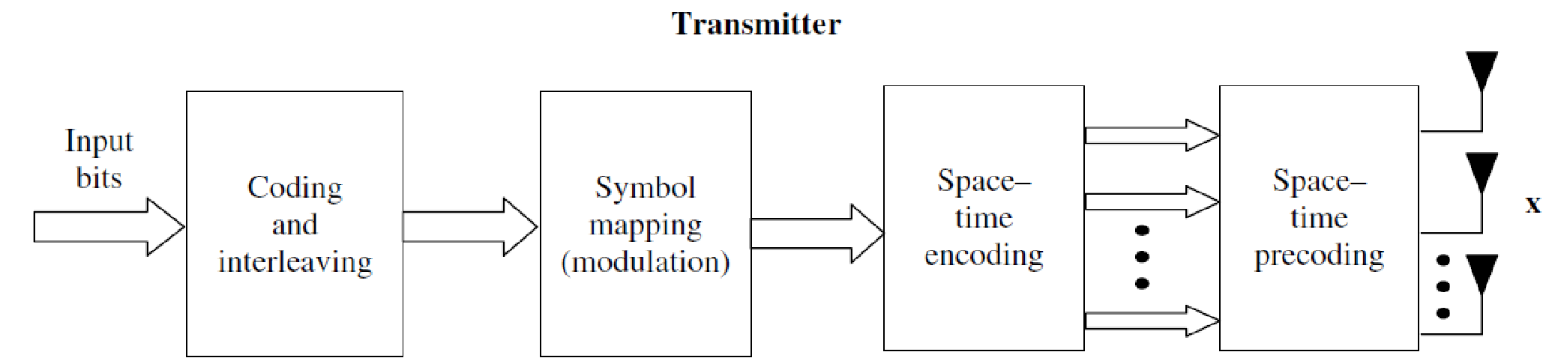
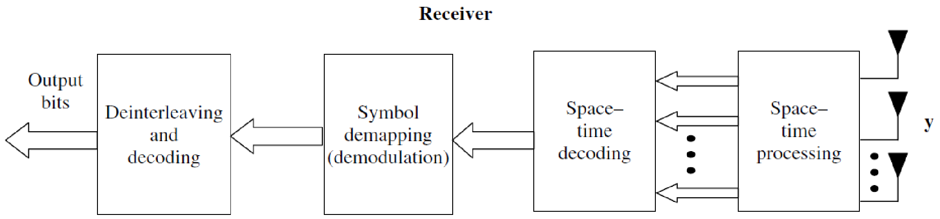
Basic TX/RX Block diagram

Slide 21
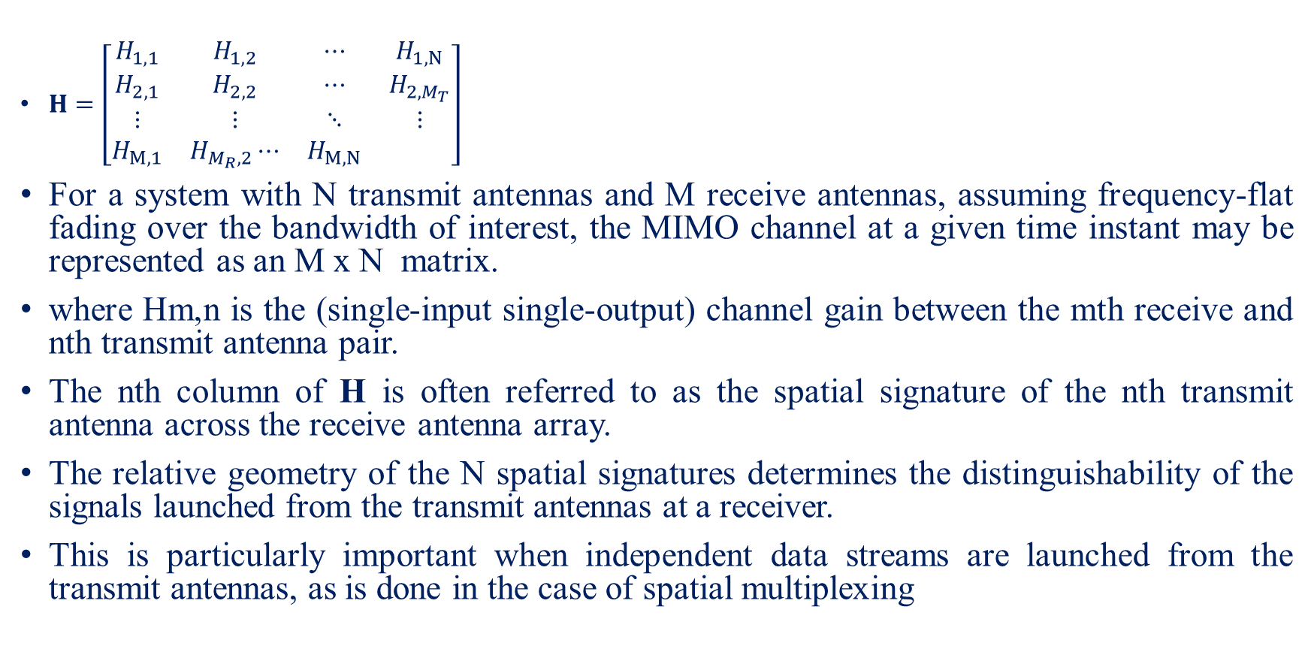
MIMO channel and Signal model

Slide 22
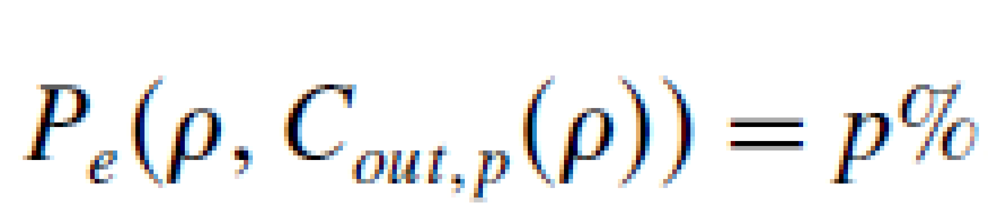
Outage capacity and multiplexing gain
The capacity of a communication channel is the maximum, asymptotic (in block length) error-free transmission rate that can be achieved. The capacity of a MIMO channel is a complicated function of the channel conditions and transmit/receive processsing constraints.
The p percentage outage capacity at SNR ρ, Cout,p(ρ), is defined as the transmission rate that can be supported by (100−p)% of the fading realizations of the channel.
Hence at SNR , if a frame is transmitted with rate Cout,p (ρ), the probability that the frame will be decoded correctly is (100−p)%.

Slide 23
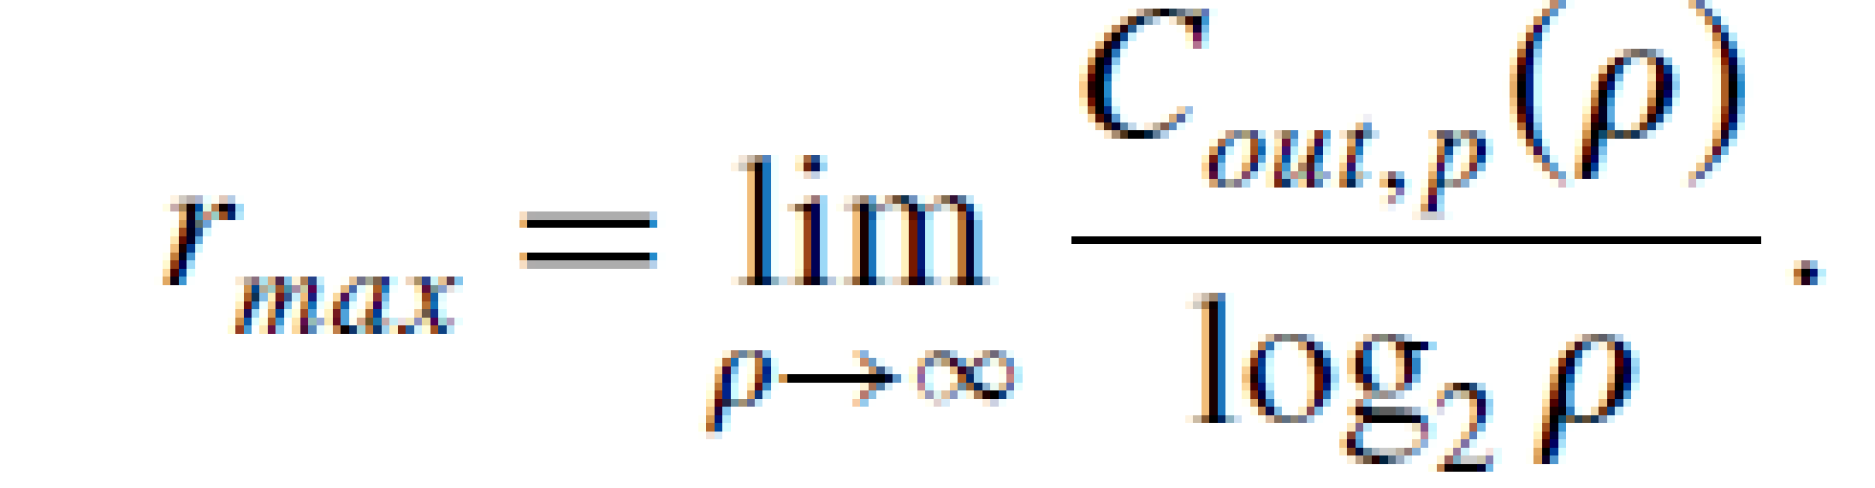
Multiplexing gain
The maximum multiplexing gain rmax that can be achieved over a MIMO channel is given by the asymptotic (in SNR) slope of the outage capacity (for fixed FER) plotted as a function of the SNR on a linear–log scale, i.e.,

Slide 24
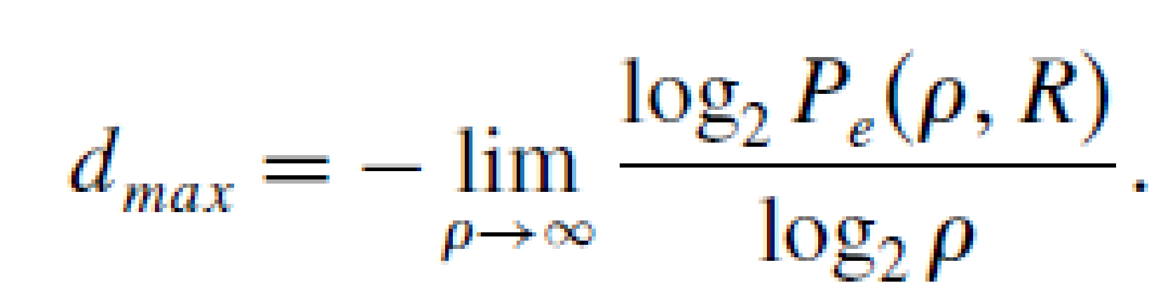
Diversity gain
The maximum diversity gain dmax that can be achieved over a MIMO channel is given by the negative of the asymptotic (in SNR) slope of FER for a fixed transmission rate, plotted as a function of SNR on a log–log scale, i.e.,

Slide 25
Case study: Recent trends in Diversity and MIMO antenna
Massive MIMO for 5G: From Theory to Practice

Slide 26
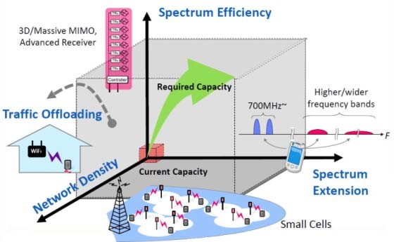

How to realize 5G?
Key requirement of 5G: 1000-fold capacity
How to realize this goal from Shannon capacity?
Three technical directions for 5G
^{No. of APs} Bandwidth
C = D * W * M * log (1+SINR)
No. of antennas
Interference mitigation
‹#›

Slide 27
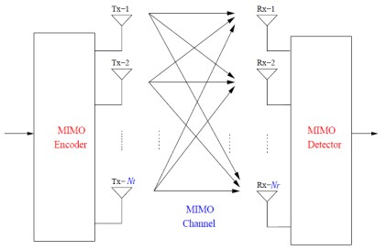
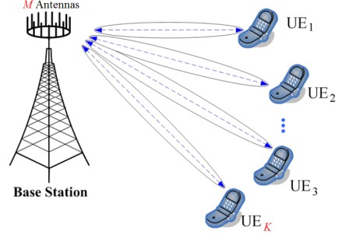
What is massive MIMO?
Use hundreds of BS antennas to simultaneously serve multiple users
Conventional MIMO
M:2~8, K:1~4 (LTE-A)
Massive MIMO
M: ~100~1000, K: 16~64
Conventional MIMO
M:2~8, K:1~4 (LTE-A)
Massive MIMO
M: ~100~1000, K: 16~64
T. L. Marzetta, “Non-cooperative Cellular Wireless with Unlimited Numbers of Base Station Antennas,” IEEE Transactions on Wireless Communications, vol. 9, no. 11, pp. 3590-3599, Nov. 2010. (2013 IEEE Marconi prize)
‹#›

Slide 28
Why Massive MIMO ?
Spatial multiplexing
Rate: min N_{r}, N_{t} log 1 + SNR
Reliability
p_{e} ∼ SNR^{–NrNt}
Array gain (beamforming)
Several antennas can be used to transmit signals
No. of antennas | Error Probability (p_{e}) | Capacity (C), bps/Hz
N_{t} = 1, N_{r} = 1 (SISO) | p_{e} ∼ SNR^{–1} | C = log 1+ SNR
N_{t} = 1, N_{r} > 1 (SIMO) | p_{e} ∼ SNR^{–Nr} | C = N_{r}log 1+ SNR
N_{t} > 1, N_{r} > 1 (MIMO) | p_{e} ∼ SNR^{–NtNr} | C = min N_{t}, N_{r} log 1 + SNR
 | N_{t}N_{r}: Diversity Gain | min N_{r}, N_{t} : Multplexing Gain
Massive N_{t}, N_{r}: significantly increased spectral efficiency
‹#›

Slide 29
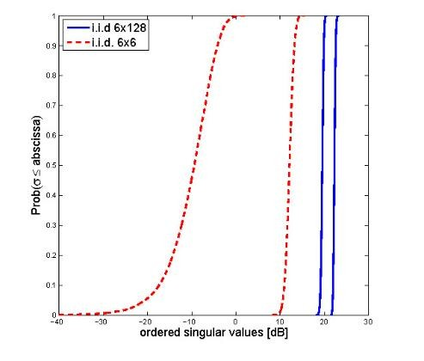
Ideal Channels
Massive MIMO has much larger ordered singular values than conventional MIMO
F. Rusek, D. Persson, B. Lau, E. Larsson, T. Marzetta, O. Edfors, and F. Tufvesson, “Scaling up MIMO: Opportunities and challenges with very large arrays,” IEEE Signal Processing Magazine, vol. 30, no. 1, pp. 40-60, Jan 2013.
‹#›

Slide 30
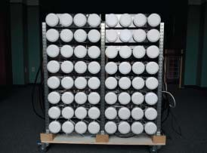
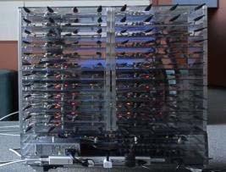
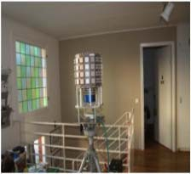
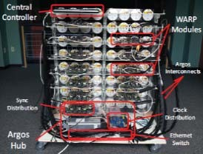
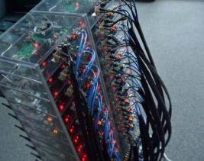
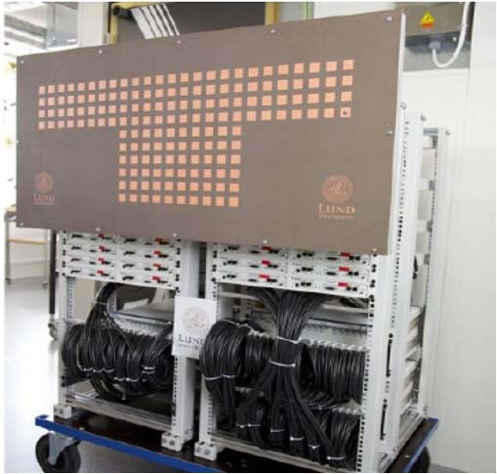
Recent Advances of Massive MIMO
Feb. 2012, Rice university & Bell labs, Argos, 64 antennas, 15 users, 85 bit/s/Hz, 1/64 power consumption
Sep. 2013, Rice university & Bell labs, ArgosV2, 96 antennas, 32 users
July 2013, Linköping & Lund University, 128
antennas, 36 users
‹#›

Slide 31
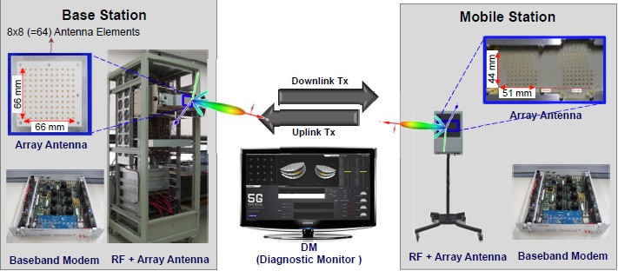
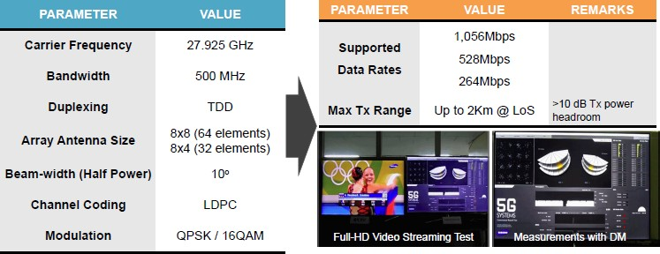
World’s First Massive MIMO Prototype
Samsung, 2014
‹#›

Slide 32
Advantages and challenges
Advantages
Improve the spectrum efficiency by orders of magnitude
Improve the energy efficiency by orders of magnitude
Challenges
Theoretical analysis with practical constraints
Reduce the power consumption of RF chains
Pilot contamination in the uplink
Efficient pilot design and channel estimation algorithm
Efficient channel feedback mechanism
Low-complexity near-optimal signal detection algorithm
‹#›

Slide 33
Millimeter-Wave Massive MIMO
Advantages
Larger bandwidth: 50MHz → 1GHz
More users and more traffic
Larger antenna array: 1~8 → 64~256
Larger antenna gain to compensate serious path loss
More data streams to improve spectral efficiency
mmWave
High frequencies
Short wavelength
Serious path-loss
Spectrum expansion
Large antenna array
Small cell
1000x data rates increase!
Xinyu Gao, Linglong Dai, Shuangfeng Han, Chih-Lin I, and Robert Heath, “Energy-Efficient Hybrid Analog and Digital Precoding for mmWave MIMO Systems with Large Antenna Arrays”, to appear in IEEE Journal on Selected Areas in Communications, available at: http://arxiv.org/abs/1507.04592

Slide 34
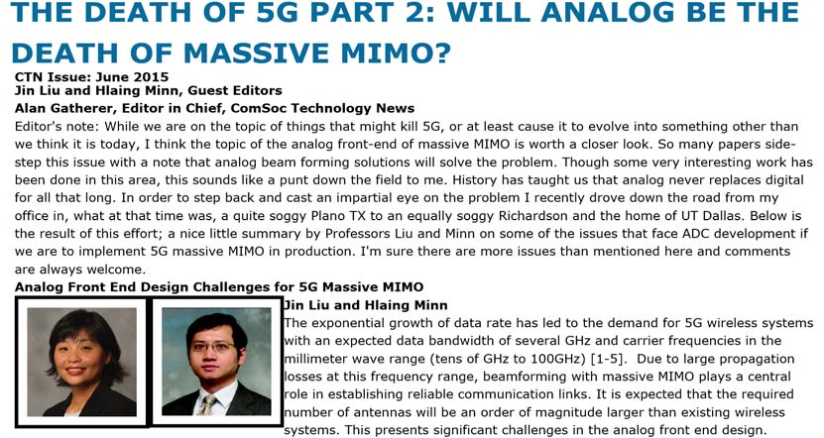
Challenges of mmWave massive MIMO
Challenges
Traditional MIMO: one dedicated RF chain for one antenna
Enormous number of RF chains due to large antenna array
High complexity in signal processing
Unaffordable energy consumption (250 mW per RF chain)
64 antennas → 64 RF chains → 16 W !
How to reduce the required number of RF chains?
How to reduce the required
number of RF chains?

Slide 35







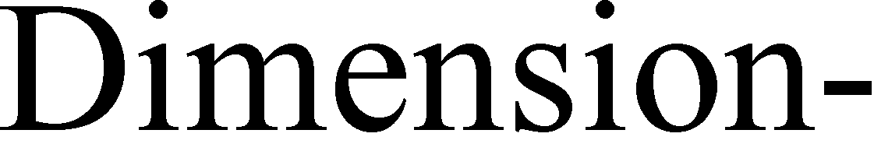









Category 1: Hybrid beamforming
Basic idea [Ayach’14,Gao’15]
Decompose fully digital beamformer of large size:
Digital beamformer with small size (realized by RF chains)
Analog beamformer with large size (realized by phase shifters)
Performance
Reduce RF chains by signal processing
Not obvious performance loss
Require complicated design
High computational complexity




[Ayach’14] O. El Ayach, et al., “Spatially sparse precoding in millimeter wave MIMO systems,” IEEE Trans. Wireless Commun., 2014.
[Gao’15] X. Gao, et al., “Energy-efficient hybrid analog and digital precoding for mmwave MIMO systems with large antenna arrays,”
IEEE J. Sel. Areas Commun., 2015.

Slide 36
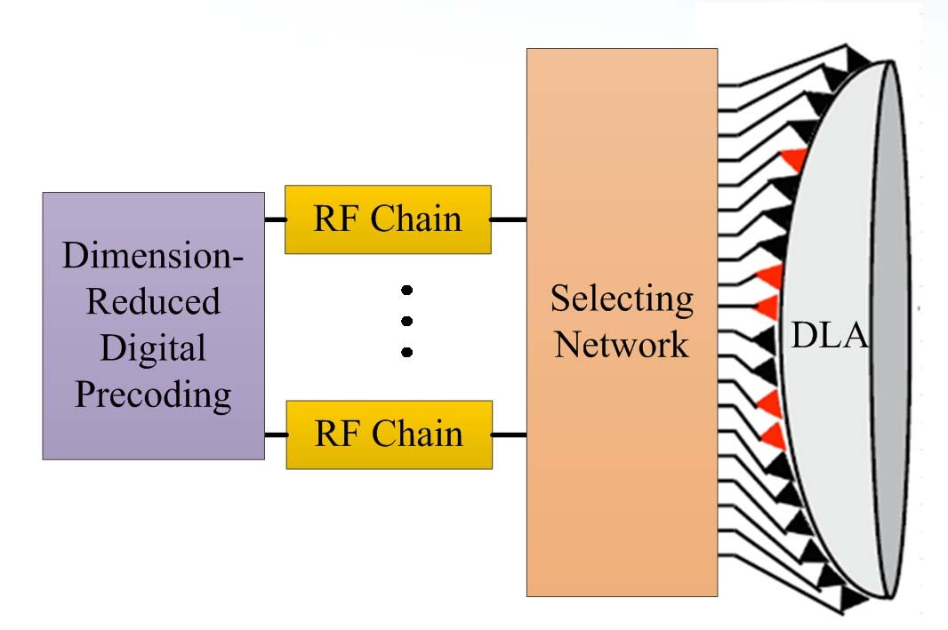
Category 2: Beamspace MIMO
Basic idea [Brady’14]
Transform spatial channel into beamspace channel (realized by lens)
Limited scatters → beamspace channel is approximately sparse
Select beams to reduce dimension (realized by switching network)
Digital beamformer with small size (realized by RF chains)
Performance
Reduce RF chains by discrete lens array (DLA)
Classical beamformers can be directly employed
Low computational complexity
A different but promising thought to reduce RF chains
A different but promising thought to reduce RF chains
[Brady’14] J. Brady, et al., “Beamspace MIMO for millimeterwave communications: System architecture, modeling, analysis, and measurements,” IEEE Trans. Ant. and Propag., vol. 61, no. 7, pp. 3814–3827, Jul. 2013.

Slide 37

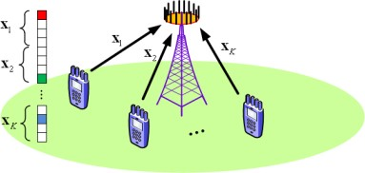
Massive MIMO with Spatial Modulation
Spatial Modulation (SM)
Exploit antenna selection pattern to transmit extra data
Energy efficient but spectrum inefficient
Massive SM-MIMO
Exploit more antennas to increase the spectrum efficiency
Key challenges: signal detection and channel estimation
Zhen Gao, Linglong Dai, Zhaocheng Wang, Sheng Chen, and Lajos Hanzo, “Compressive Sensing Based Multi-User Detector for Large-Scale SM-MIMO Uplink,” to appear in IEEE Transactions on Vehicular Technology.

Slide 38
Extension of Massive MIMO
Massive MIMO for THz
Massive MIMO and NOMA
Massive MIMO for UDN
Massive MIMO for Energy Harvesting
Massive MIMO for Wireless Power Transfer
Linglong Dai, Bichai Wang, Yifei Yuan, Shuangfeng Han, Chih-Lin I, and Zhaocheng Wang, “Non-Orthogonal Multiple Access for 5G: Solutions, Challenges, Opportunities, and Future Research Trends,” IEEE Communications Magazine, vol. 53, no. 9, pp. 74-81, Sep. 2015.

Slide 39
Summary on the case study
Massive MIMO is very promising technology for 5G wireless communications
Theoretically, massive MIMO can increase the spectrum and energy efficiency by orders of magnitude
Several practical solutions to address challenging problems to realize massive MIMO
Performance analysis with practical constraints
Pilot decontamination based on graph coloring
Efficient pilot design and channel estimation based on CS
Low-complexity multi-user detection for uplink massive SM-MIMO
Energy-efficient SIC-based hybrid precoding
Beamspace massive MIMO
Future research directions
mmWave massive MIMO, massive SM-MIMO, beamspace massive MIMO
Massive MIMO for NOMA, UDN, THz, energy harvesting, wireless power transfer…

